Slide 1

Crypto Currency Data Analysis Dashboard

Slide 2
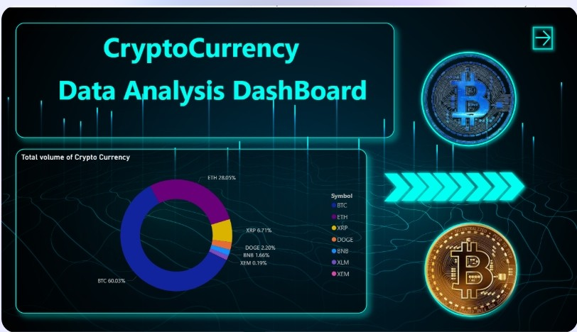
Dashboard Home page

Slide 3
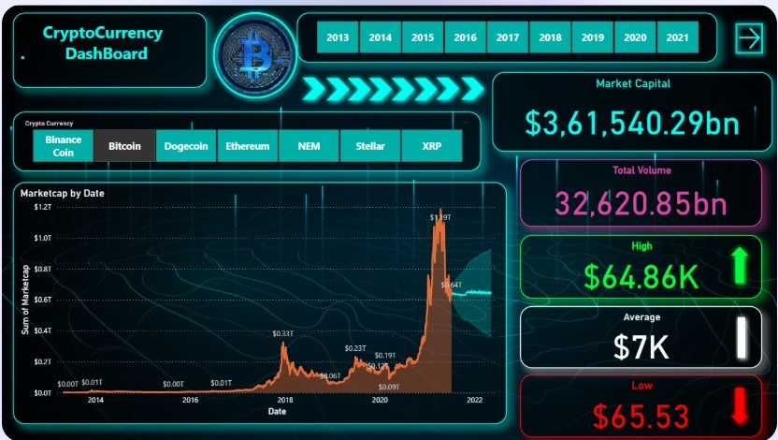
Market Capitals page

Slide 4
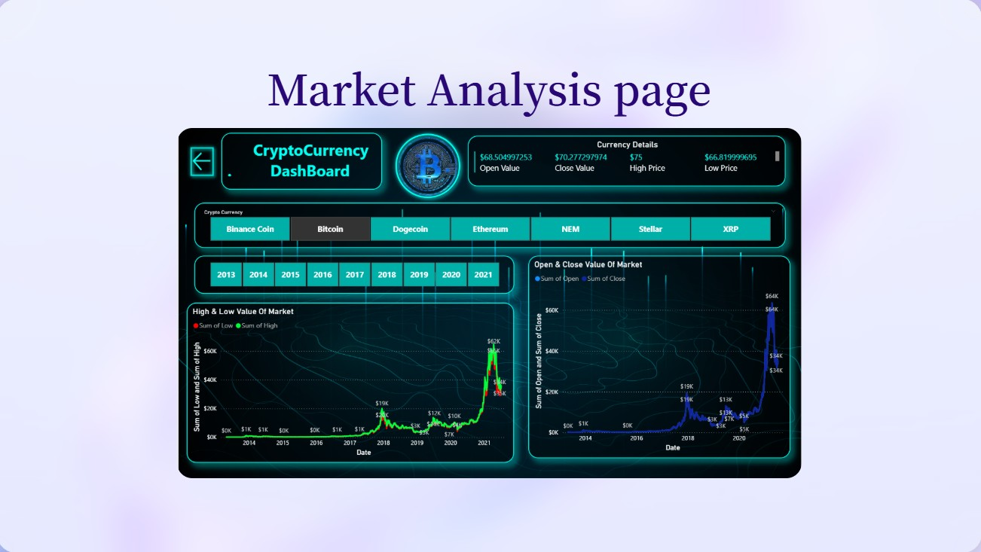

Slide 5
CONTENTS
Project Overview
Problem Statement
Solution Approach
Dataset Overview
Dashboard Structure
KPI Cards Overview
Volume Distribution Analysis
Market Capital Trend Analysis
High & Low Price Analysis
Open & Close Price Analysis
Interactive Filters & Insights
Key Insights & Findings
Business Value & Use Cases
Conclusion & Future Scope

Slide 6




1. Project Overview
What is Cryptocurre ncy Market Analysis
Importance of Data Visualization
· Data visualization is crucial in crypto markets for effective analysis and decision­ making.
Objective of the Power Bl Dashboard
· The objective is to provide an interactive platform for data analysis.
Cryptocurrenc y market analysis is essential for understanding trends) risks) and opportunities.

Slide 7


2. Problem Statement
I
The cryptocurrency market is highly volatile.
It is difficult to analyze raw crypto data across years and currencies.
There is a need for an interactive analytical dashboard.
0

Slide 8


3. Solution Approach
-₋
Use Power Bl for interactive data visualization.
Analyze market capitalization, volume, and price movement.
Enable year-wise and currency-wise filtering.
Provide quick insights through KPls and charts.

Slide 9
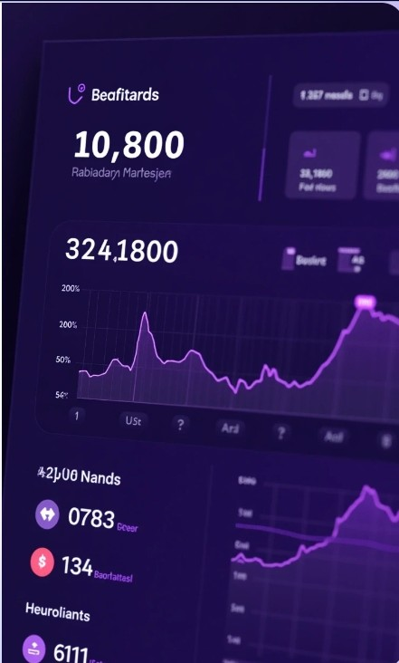
4. Dataset Overview
Cryptocurrencies included
Bitcoin, Ethereum,Coin, XRP, Dogccoin, Stellar, NEM.
Time period
2013 - 2021.

Slide 10
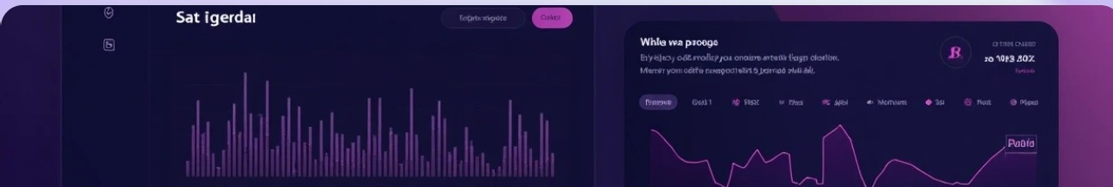




5. Dashboard Structure
Multi-page Power Bl dashboard.
Overview page.
Market Capital Analysis page.
Market Details page.

Slide 11
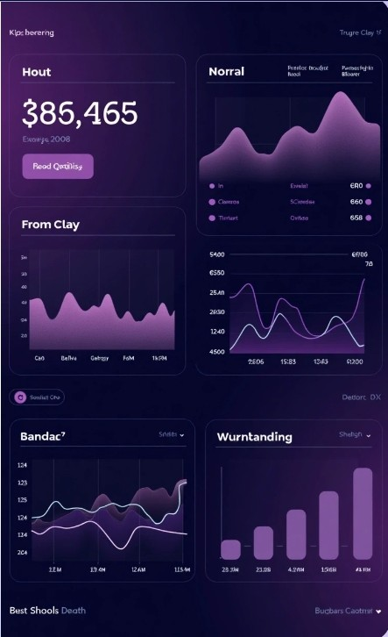
6. KPI Cards Overview
Market Capital.
Total Volume.
Highest Price.
Average Price.
Lowest Price.
Explain how KPls provide instant insights.

Slide 12
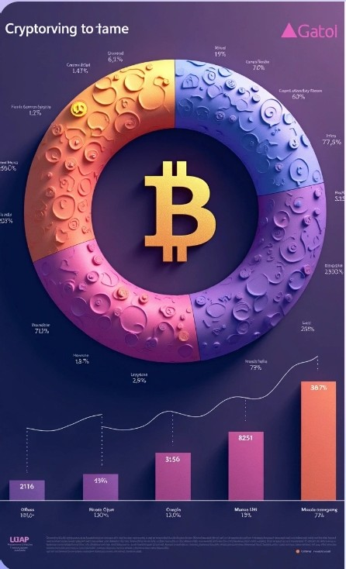


7. Volume Distribution Analysis
Donut chart
2
Bitcoin Comparison
showing | dominating | between
total | total market | maJor
volume by | volume. | cryptocurre
cryptocurre |  | ncies.
ncy.

Slide 13
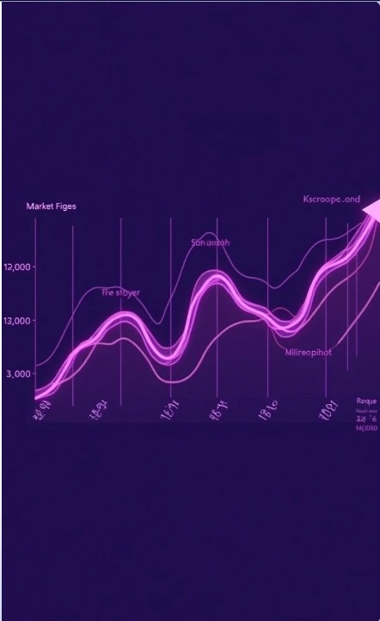
8. Market Capital Trend Analysis
Line I Area chart showing market capitalization by date.
Identify growth phases and market peaks.
Highlight major surge periods.

Slide 14



9. High & Low Price Analysis
1 Line chart comparing
high and low prices.
Shows market volatility.
Helps assess risk in crypto investments.

Slide 15

10. Open & Close Price Analysis
1
Line chart | Identifies | Shows
for open | bullish and | market
and close | bearish | stability or
values. | trends. | fluctuations.

Slide 16
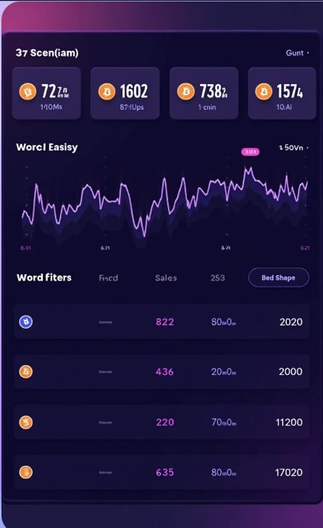
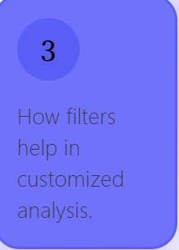
11. Interactive Filters
& Insights
1
2
Year slicer
(2013-2021).
Cryptocurrenc y selection buttons.

Slide 17

.
12. Key Insights & Findings
»)
High volatility observed during peak years.
•••
,.,
>
• •
Bitcoin has the highest market dominance.
Market shows exponential growth after 2017.
Volume strongly correlates with market capitalization.

Slide 18



13. Business Value &
Use Cases
Helps investors understand market trends.
Supports data-driven investment decisions.
Useful for financial analysts and researchers.
4 Reduces analysis time significantly.

Slide 19
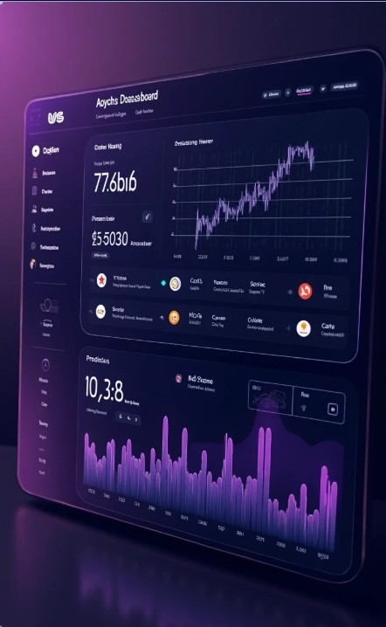
14. Conclusion & Future Scope
The dashboard simplifies complex crypto data.
It enhances decision-making with visuals.
Future improvements:
Real-time data integration.
Predictive analysis using ML.
·More cryptocurrencie s.

Slide 20
Thank You

